Slide 1


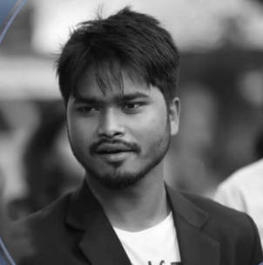




Shashank Kumar
Shashank Kumar
Kiran Chandra
Ranjith Raj
Summer of Code (GSoC)
Summer of Code (GSoC)
Tech for Democracy
Aadhaar Security
What is Open Source?
How to start Contributing?
Why is Google Summer of Code important?
What is Open Source?
Google’s Contribution to Open Source.
Coding in Google.
Data Protection and Surveillance.
Effect of Technology on Democracy.
Social Security.
Centralization.
Direct Benefit Transfer (DBT).
Sensitivity of Privacy.
@realslimshanky
@realslimshanky
@kiranychandra
@RanjithRajV
@shashankkumarkushwaha
@ranjithrajv
@shashankkumarkushwaha
@kiran-chandra-a4109b60

